Slide 1
Preparing Posters
1) Size of the poster: The dimensions of the usable work area of the board are 1.4 meters high by 0.9 meters wide. Use these dimensions only.
2) Text font size: (Is my font size legible from 3 to 6 feet?)
a) Type of font:
Arial for Headings & Subheading, Times New Roman for Body of text
b) Font size:
Title: Ideal font size is at least 72 for poster titles. Titles should be viewable from 6 feet away to catch the reader’s attention.
Author(s), Programme name and Name of supervisor should be font size 44. (This should be identical to that given in the abstract)
Block or Body Text: 36 point font is ideal. The minimum is 24 point.
3) Poster color:
Title banner: The title banner should include the title of the poster, authors, programme and the name of supervisor in ways exactly like that appeared in your abstract. The color background of the title page should be according to the specified for the different programmes. (see subsequent slides)
Poster text : For the remaining part of the poster, black text with a white background is ideal and proves to be much more legible. Other colors are acceptable. This is only a recommendation.

Slide 2
Example of font size and color of title banner
This is the poster
By X. X. Yan and Y. Y. Zee, Artificial Intellegence , FST

Slide 3
Example of font size and color of title banner
This is the poster
By X. X. Yan and Y. Y. Zee, Applied Mathematics, FST

Slide 4
Example of font size and color of title banner
This is the poster
By X. X. Yan and Y. Y. Zee, Applied Psychology, FST

Slide 5
Example of font size and color of title banner
This is the poster
By X. X. Yan and Y. Y. Zee, Computer Science and Technology, FST

Slide 6
Example of font size and color of title banner
This is the poster
By X. X. Yan and Y. Y. Zee, Data Science, FST

Slide 7
Example of font size and color of title banner
This is the poster
By X. X. Yan and Y. Y. Zee, Environmental Science, FST

Slide 8
Example of font size and color of title banner
This is the poster
By X. X. Yan and Y. Y. Zee, Financial Mathematics, FST

Slide 9
Example of font size and color of title banner
This is the poster
By X. X. Yan and Y. Y. Zee, Food Science and Technology, FST

Slide 10
Example of font size and color of title banner
This is the poster
By X. X. Yan and Y. Y. Zee, Statistics, FST

Slide 11
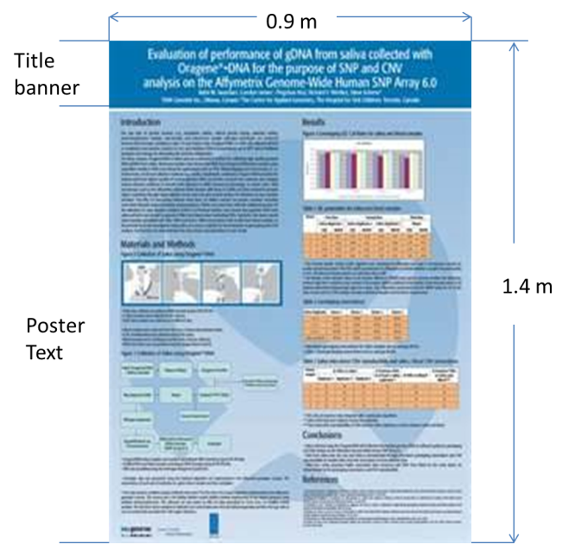
Example of a poster

Slide 12
Main text of poster
4) The main text of the poster should include the abstract, Introduction, Materials and Methods, Results and Discussion, Conclusion, and References.
a) The abstract should be placed at the left hand upper corner below the title. The abstract should be identical to that submitted previously. One should not attempt to change the content of the abstract.
b) Introduction: to follow the abstract.
c) Materials and Methods : briefly describe procedures and materials. Define all trade names first, and then use generic names throughout. All compounds and drugs must be identified.
d) Results and Discussion : Authors have complete freedom in displaying poster information in figures, tables, text, photographs, etc. Do not use staples or tape.
e) Conclusion : Brief and concise wordings to show the outcome of the study.
f) References : References should be cited according to the format used in the respective programme. They should be numbered and in alphabetic order.

Slide 13
Other important notes
5) Important notes:
Make sure that there aren’t too many lines per text block.
A series of word-processed pages attached to the poster board is not an acceptable poster.
Electronic presentations are not permitted.
6) Using graphics:
Use captions or labels for images.
Are the images appropriate?
Don’t avoid using images! Use them in a creative manner. This will draw the audience to your message.
Use charts (pie charts, line graphs, etc.) appropriately, with a clear explanation of the data being used.
Do not place images over text. This will distract the audience.
Lastly, make sure all information is in logical order.
7) Other details:
Authors must wear name badges so they can be identified as one of the authors.
Presenters should be dressed in business attire (coat and tires for men and skirts or pants for women).
Blu-Tack will be available for affixing the poster.
All poster boards will be numbered. Please check your email confirmation for your unique poster number.
You may set up an hour before the poster event starts. The poster will be displayed for at least 1 day, and the Faculty will take care of removing it afterwards.

